Slide 1
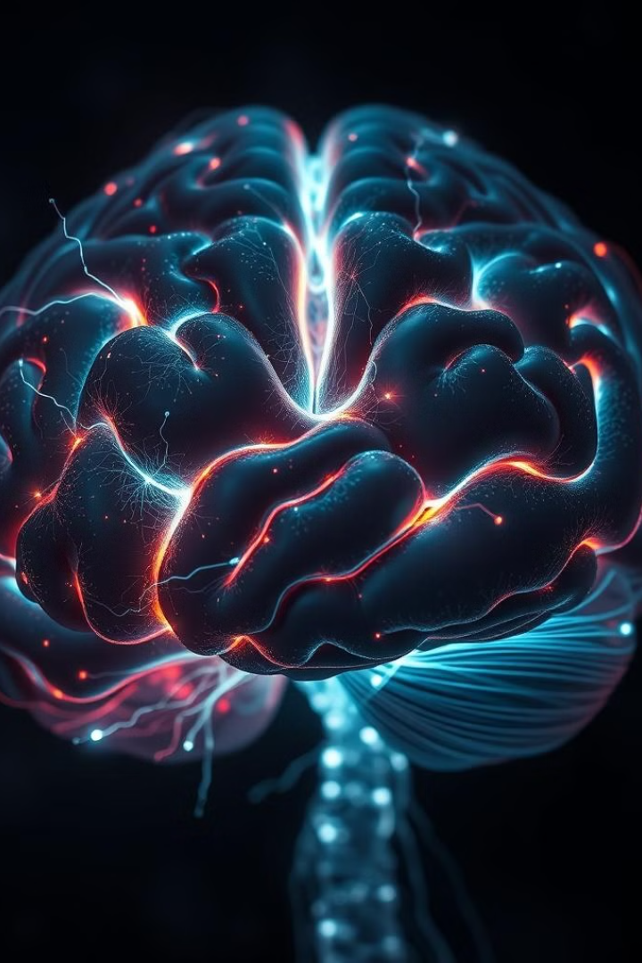
Brain-Computer Interface: A Technical Exploration
Brain-Computer Interfaces (BCIs) represent a groundbreaking intersection of neuroscience, computer science, and engineering. These systems aim to establish a direct communication pathway between the human brain and external devices, unlocking new avenues for interaction, control, and assistive technologies. This presentation will take a deep dive into the technical foundations and advancements powering the field of BCIs, exploring the key components, signals, and algorithms that enable this transformative technology.
by kandukuri Harshitha

Slide 2
Introduction to Brain-Computer Interface
A Brain-Computer Interface (BCI) is a technology that allows direct communication between the brain and an external device, such as a computer or a robotic arm. BCIs capture brain signals, process them, and translate them into commands to control devices, without needing muscle movements.
The main goal of BCIs is to help people with disabilities, such as those who are paralyzed, by enabling them to control devices using just their thoughts. BCIs also have other uses, like enhancing video games, improving mental health, or even controlling drones.
In simple terms, BCIs act as a bridge between the brain and machines, making it possible to interact with technology through brain activity alone.
Need for Brain-Computer Interface (BCI):
1. Communication for Locked-In Patients: BCIs enable communication by converting brain signals into text or speech.
2. Helping People with Disabilities: BCIs let paralyzed individuals control devices with their thoughts.
3. Rehabilitation and Therapy: BCIs help stroke patients regain motor skills through mental practice
4. Advancing Technology and Entertainment: BCIs improve gaming and virtual reality with thought control.
5. Research and Understanding the Brain: BCIs aid brain research, leading to new treatments for disorders.

Slide 3
History of BCI
1960s-1970s: Early Concepts
The idea of BCIs emerged, with Jacques Vidal coining the term. Early experiments used EEG to explore brain signal control of external devices.
1980s-1990s: Initial Research
BCIs began to take shape, with studies demonstrating cursor control via brain activity. Invasive techniques emerged, allowing electrodes to be implanted in animal brains for prosthetic control.
2000s: Breakthroughs and Commercialization
Significant advancements in non-invasive BCIs enabled users to control devices with imagined movements. Companies like Emotiv and NeuroSky launched EEG headsets for gaming and wellness.
2010s: Major Achievements
High-resolution BCIs, such as microelectrode arrays, facilitated more precise control. Projects like BrainGate enabled paralyzed individuals to control devices through thought.
2020s: Recent Developments
Innovations like Neuralink aim for high-bandwidth communication between the brain and machines. The integration of AI and machine learning is enhancing BCI performance, expanding applications in mental health and beyond.

Slide 4

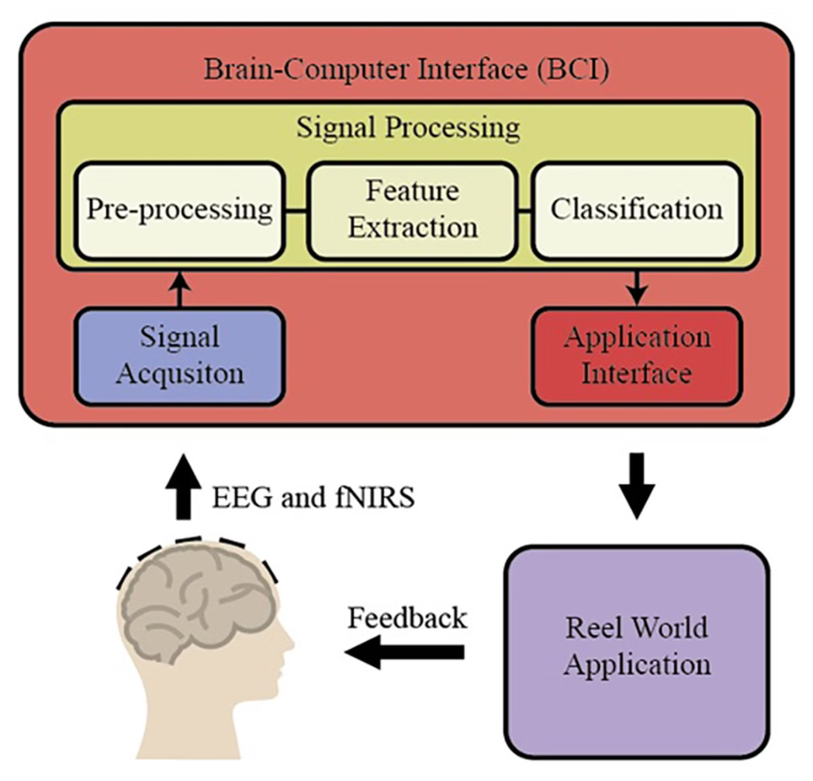
Components of a BCI
Brain-computer interfaces are complex systems that require the integration of several key components. These components work together to acquire, process, and decode brain signals, enabling communication and control between the brain and external devices.
A Brain-Computer Interface (BCI) system comprises three fundamental components—Signal Acquisition, Signal Processing, and BCI Application. These components work in tandem to facilitate the flow of brain signals to the target application, such as controlling a robotic arm. In certain situations, control signals from the BCI application may also be sent back to the brain to stimulate sensory functions like vision and hearing.

Slide 5
Signal Acquisition
This component is responsible for capturing brain signals, which are oscillating electrical voltages generated by the brain's biological activities. The key aspects include:
Types of Signals:
Electroencephalography (EEG): Measures electrical activity on the scalp.
Electrocorticography (ECoG): Measures signals from the exposed cerebral cortex.
Local Field Potential (LFP): Captures electric potential around neurons.
Neuronal Action Potential: Records rapid changes in the membrane potential of neurons.
Categories:
Invasive BCI: Involves electrodes implanted under the scalp, providing accurate readings but requiring surgery.
Non-invasive BCI: Involves electrodes placed on the scalp, which is safer but may yield weaker signals, necessitating more complex processing.
Signal Processing: Before moving to the next component, the acquired signals undergo filtering, amplification, and digitization, with the overall performance relying heavily on the signal-to-noise ratio.

Slide 6
Signal Processing
This component consists of several critical stages to interpret the acquired brain signals effectively:
Feature Extraction:
This stage involves identifying key electrophysiological features from the signals that correlate with the user's intent, such as movement or speech.
Techniques used may include time-domain or frequency-domain analysis, focusing on attributes like amplitude, latency, or firing rates.
Feature Classification:
Once features are extracted, this stage recognizes patterns corresponding to specific actions, enabling the BCI system to identify intended commands (e.g., moving a robotic arm).
This is typically implemented using machine learning algorithms to classify the features.
Feature Translation:
The classified features are converted into commands for operating external devices, such as moving a cursor or controlling volume.
A critical aspect here is adaptability, which allows the system to adjust to changes in the brain signal features dynamically.

Slide 7
BCI Application
The BCI Application component is the final stage of a Brain-Computer Interface (BCI) system, where the processed signals are translated into commands that control external devices or restore lost functionalities. The primary goal of BCI applications is to enable users to interact with external devices using their brain signals. This can facilitate communication, assist with mobility, or restore lost sensory functions. BCI applications have diverse uses, particularly for individuals with motor disabilities or neurological conditions.
The final component translates the commands generated in the previous stage into control of external devices, which can include:
- Cursor control for text selection on computers.
- Wheelchair control for mobility assistance.
- Robotic arm control for assisting with physical tasks.
Additionally, in applications aimed at restoring lost functionalities, control signals may be sent back to the brain or other body parts to stimulate normal human functions like vision or hearing.

Slide 8
Applications of BCI
Medical Applications
Rehabilitation: Helping stroke patients regain motor skills.
Assistive Devices: Enabling individuals with disabilities to control prosthetics or wheelchairs.
Communication Aids: Assisting locked-in syndrome patients in communicating.
Gaming and Entertainment
Interactive Experiences: Enhancing video games and virtual reality by allowing users to control elements with their thoughts.
Research
Cognitive Studies: Utilizing BCIs to explore brain functions and cognitive processes for better understanding of neurological conditions.
Military and Defense
Robotic Control: Potential applications for controlling drones and robotic systems, enhancing operational capabilities.

Slide 9




Machine Learning Techniques for BCI
Classification
Regression
Unsupervised Learning
Transfer Learning
Machine learning models, such as support vector machines (SVMs), linear discriminant analysis (LDA), and convolutional neural networks (CNNs), are employed to classify the user's mental states or intended actions based on the extracted features from the brain signals.
Regression techniques, including linear regression and Kalman filtering, are used to continuously estimate and predict the user's control signals, enabling smooth and proportional control of external devices or virtual environments.
Unsupervised learning methods, such as clustering and dimensionality reduction, can be used to identify patterns and structure in the brain signals without relying on labeled data, potentially revealing novel insights and relationships.
Transfer learning approaches allow for the adaptation and personalization of BCI systems, leveraging previously acquired knowledge from other users or tasks to improve the performance and reduce the training time for individual users.

Slide 10
Challenges and Limitations of BCIs
Signal Quality
Noise Interference: External noise and muscle activity can distort brain signals.
Variability: Individual differences and fluctuating brain activity lead to inconsistent performance.
User Variability
Individual Differences: Age and cognitive abilities affect BCI control effectiveness.
Learning Curve: Users require time to adapt, with experiences varying widely.
Ethical Concerns
Privacy Issues: Access to sensitive thoughts raises data security concerns.
Potential for Misuse: Mind-reading capabilities could be exploited for manipulation.
Ethical Debates: The implications of thought access spark discussions about privacy and autonomy.

Slide 11
Future Trends in BCIs
Advancements in Machine Learning
Deep Learning and AI: These technologies will improve BCI systems by enhancing signal processing, increasing accuracy in interpreting brain signals, and enabling adaptive learning based on user feedback.
Wearable Technology
Integration with Wearables: BCIs will be integrated into devices like smart glasses, headsets, and fitness trackers, making them more accessible and applicable in daily life, healthcare, and gaming.
Neurofeedback
Cognitive Training and Mental Health: BCIs will be used for neurofeedback applications, helping users train their brain activity for improved cognitive function and aiding in the treatment of conditions like anxiety and depression.

Slide 12
Thank You!

